Slide 1

SMAI
Groove2Groove
One-Shot Music Style Transfer With Supervision From Synthetic Data
Meenakshi | Anindita | Arshini
6 MAA

Slide 2
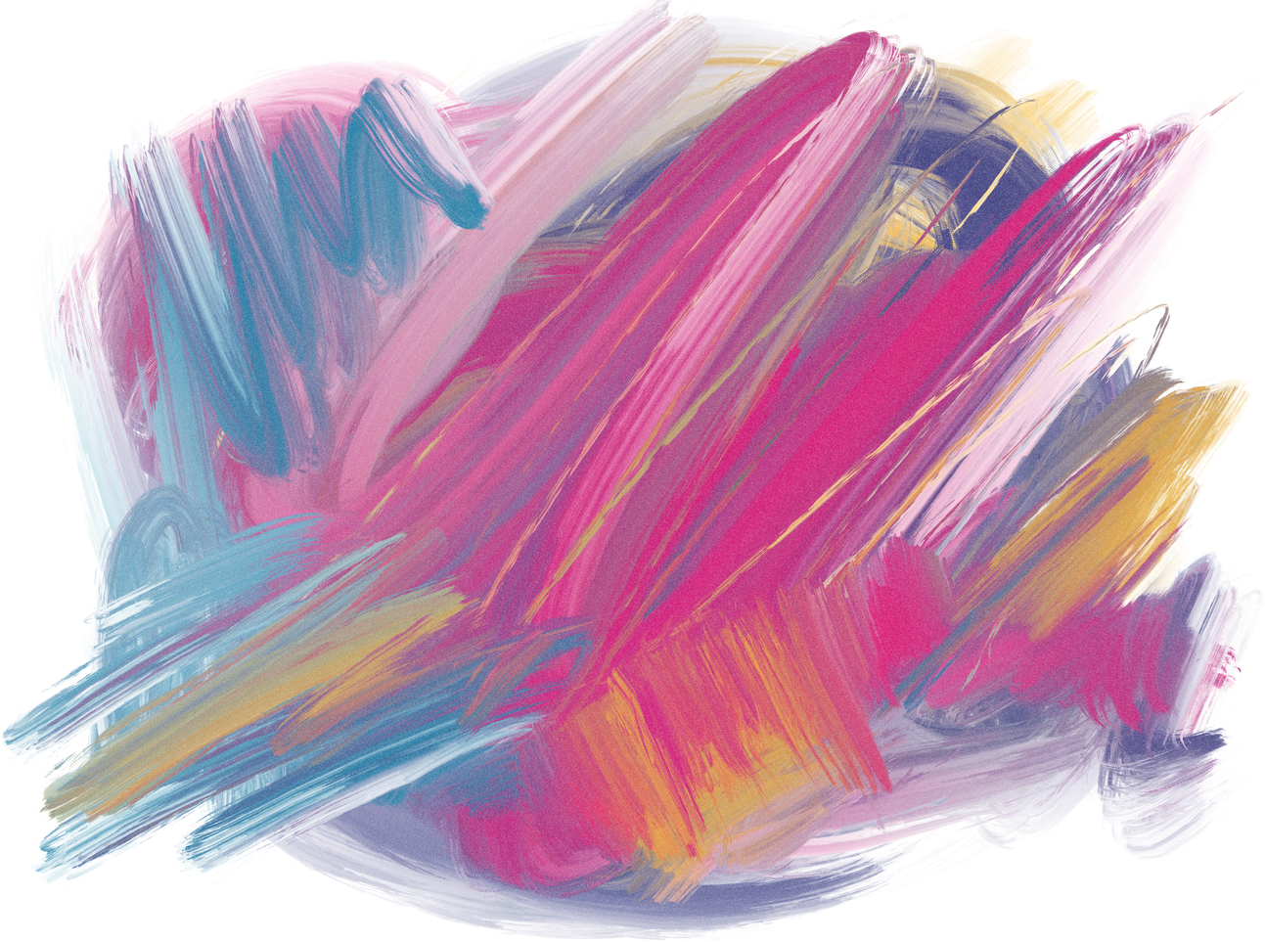
SMAI
Introduction
Problem Statement
Previous Solutions
Content
Proposed Solutions
Model Architecture
....
6 MAA
01
02
03

Slide 3



SMAI
Introduction
In this paper, the authors present an innovative approach to music style transfer, which refers to the process of transforming a piece of music from one genre or style to another while retaining its fundamental musical structure.
6 MAA
02
03
04

Slide 4
SMAII
Problem
Statement
uses synthetic data to train a neural network for one-shot style transfer.
allows for the network to learn the underlying patterns and features of different music styles and genres
The paper addresses the difficulty of achieving music style transfer without large amounts of labeled data or manual rule specification.
Previous methods have been limited by data availability/quality, the complexity of timbral features, and the inflexibility of rule-based approaches.
it can
be applied in various contexts for music production and personalization
6 MAA
03
04
05

Slide 5
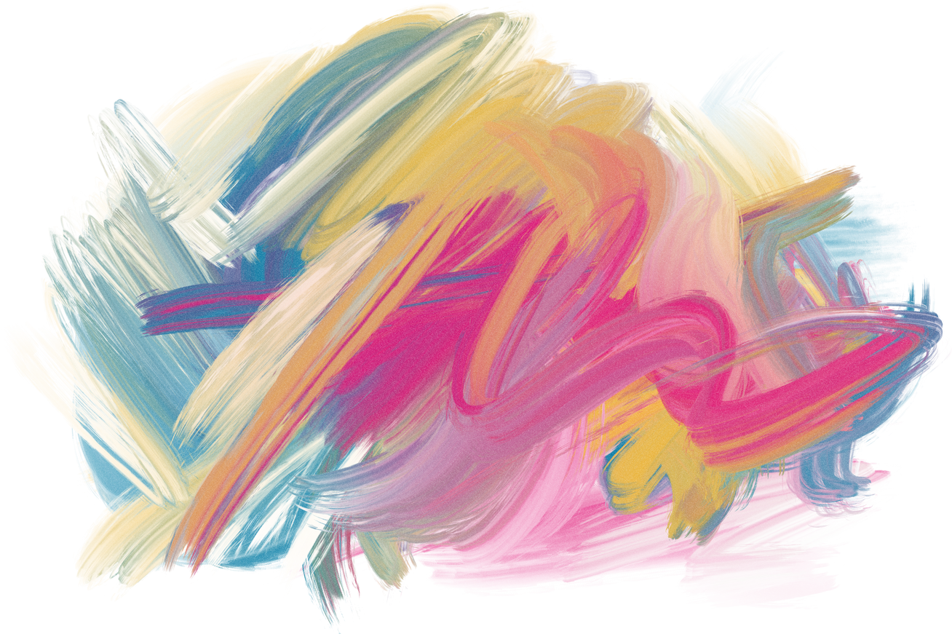
SMAI
Previous Solutions
Prior methods require large amounts of labeled data and are specific to few genres of music only
Solution 1
Solution 2
Solution 3
Training neural networks on labeled data but it can be limited by data availability/quality and the subjective nature of musical genres.
Timbre transfer techniques extract timbral features from one piece of music and transfer them to another, but accuracy can be limited by the complexity of timbral features.
Rule-based methods for music style transfer involve manual specification of rules, which can be time-consuming and lack flexibility. The rules may not be generalizable across different genres or musical contexts.
6 MAA
04
05
06

Slide 6
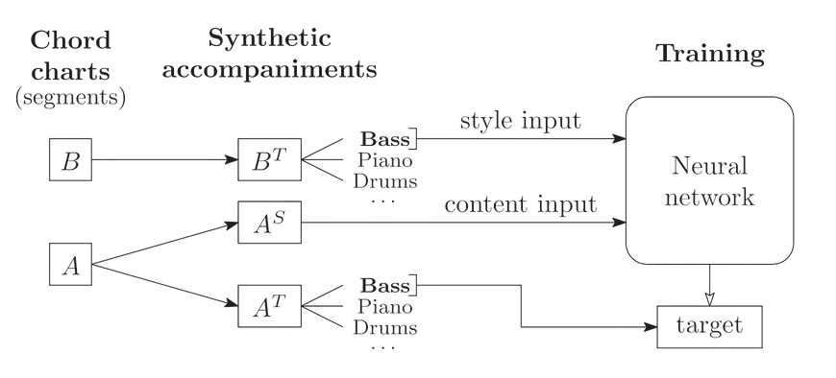
SMAI
Proposed Solution
The paper proposes a solution to convert a song X so as to match the style of a given song Z where both are given as MIDI.
Generate a new accompaniment for X in the style of Z is what we have to do.
B is the chord chart of the input song fragment and A is the chord chart of the target song.
The style input is given by B and the content input i.e. the chord chart is given by A.
The neural network trained on synthetic datasets with the same format will give a song output such that it has the style of B and the content of A i.e. target
6 MAA
05
06
07

Slide 7

SMAI
The convolutional layers help reduce the size of the input.
Content encoder applies 2D convolutions to the (input), flattens the resulting feature map to get sequence of 1024-dimensional vectors with two vectors per measure, then fed to a GRU layer with 200 units, getting a 200-dimensional vector
Style encoder takes input token embeddings and applies 3 convolutional layers, compressing the sequence 8 times followed by a GRU with 500 units, and only the last state is kept as the style embedding
Model Architecture
The neural network used follows the encoder decoder pattern -- one each for content and style and a decoder for the output. The encoders use a CNN with ELU activations and an RNN with a gated recurrent unit.
6 MAA
06
07
08

Slide 8
SMAI
Evaluation Metrics
we need to make sure the output matches the original style and has the content as well
Style Fit
Content Preservation
Each accompaniment track within a given style is generated independently based on the chord charts so it is evaluated separately for each track.
Cosine similarity is used to measure the fit of the generated output to the target style, by comparing a 2D histogram of note pairs to a reference style profile and is called pairwise time-pitch.
Calculated as the frame wise cosine similarity between the chroma features of content input given to the encoder and the output produced.
Evaluated on the whole generated output as each instrument separately wont give complete harmony of the music and the content input and output might use different instruments so one-on-one pairing cannot be done.
6 MAA
07
08
09

Slide 9
SMAI
First compute an aggregate style profile for all outputs in each style. Then we measure the cosine similarities to the reference profiles. The mean and standard deviation over all styles are then calculated. This is called macro metrics.
For non-synthetic datasets, compute a separate style profile for each output and then cosine similarity is measured to corresponding style input profile. This is called nano metrics.
EvaluationMetrics
6 MAA
13
14
15

